Slide 1
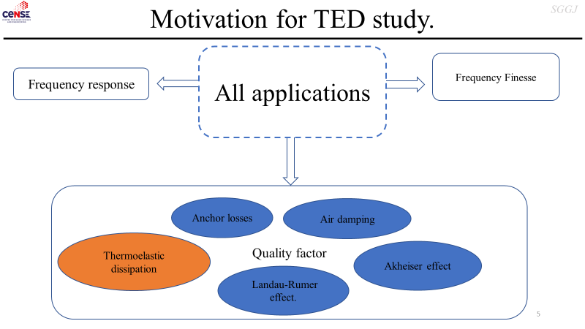
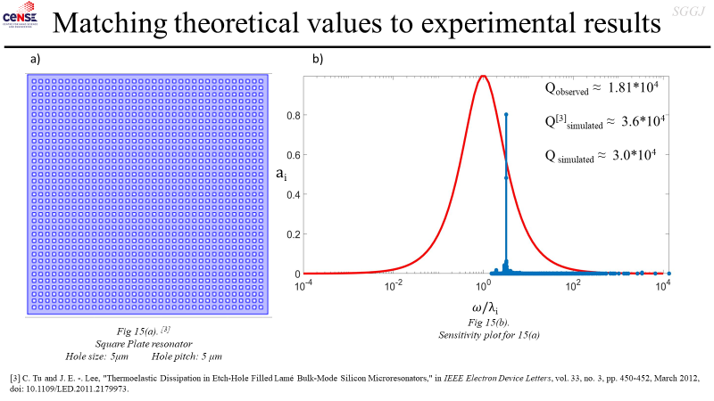
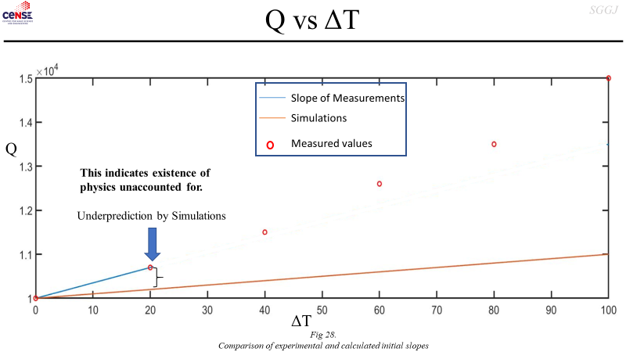
THERMO-ELASTIC DISSIPATION (TED)
TED Simulations
Mysteries of TED

Slide 2
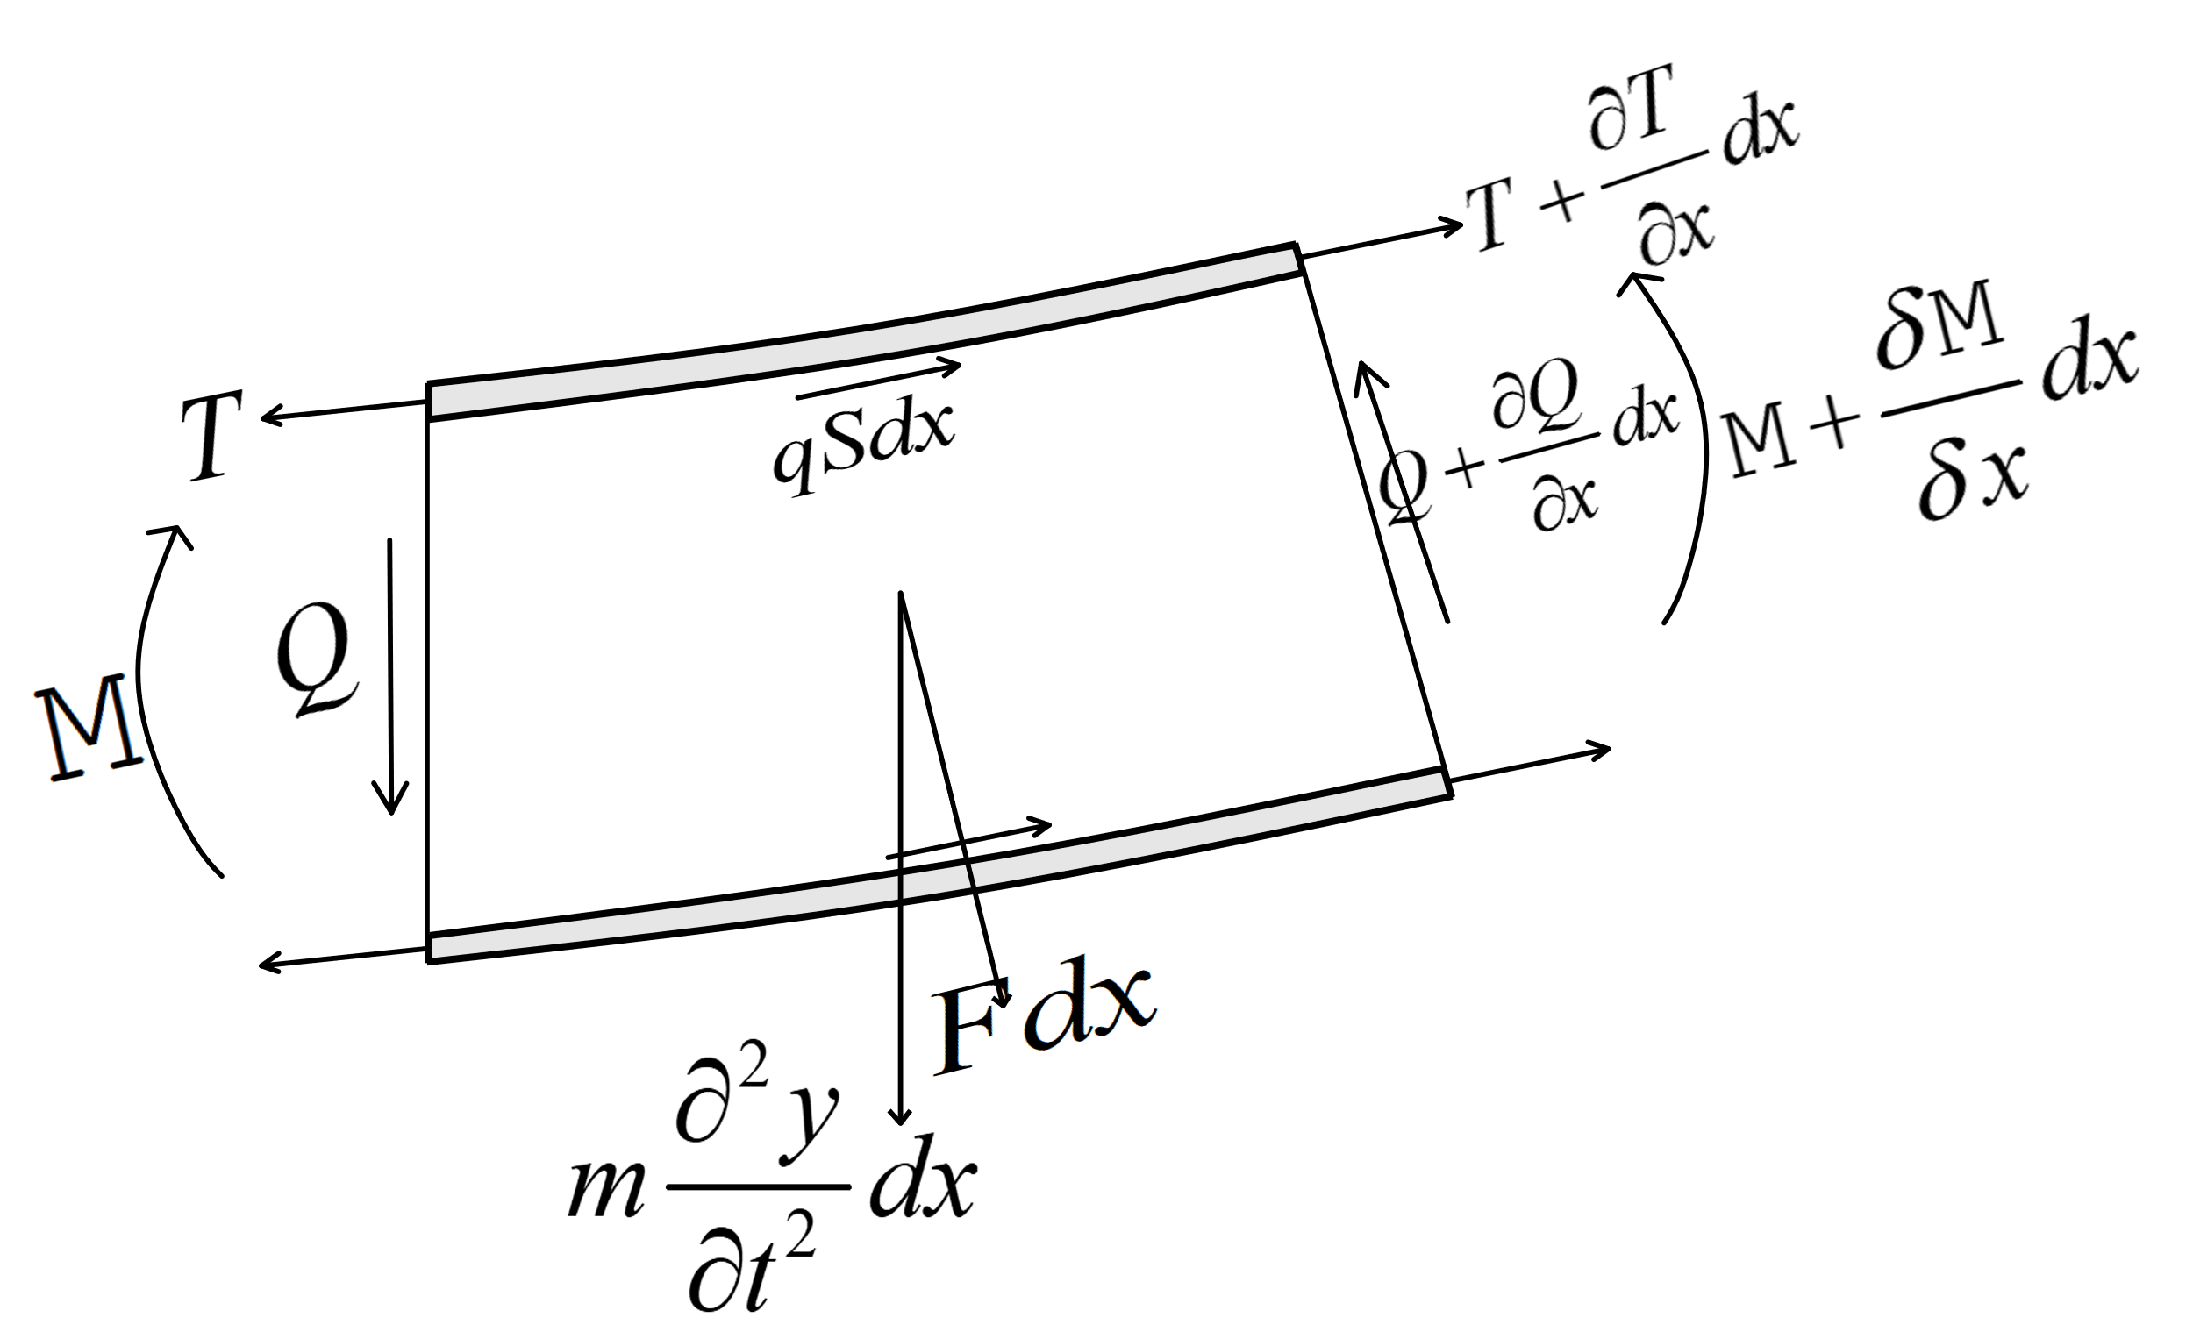
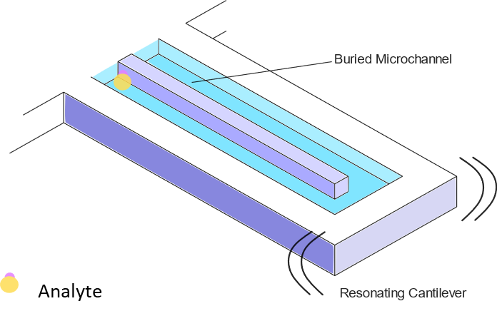
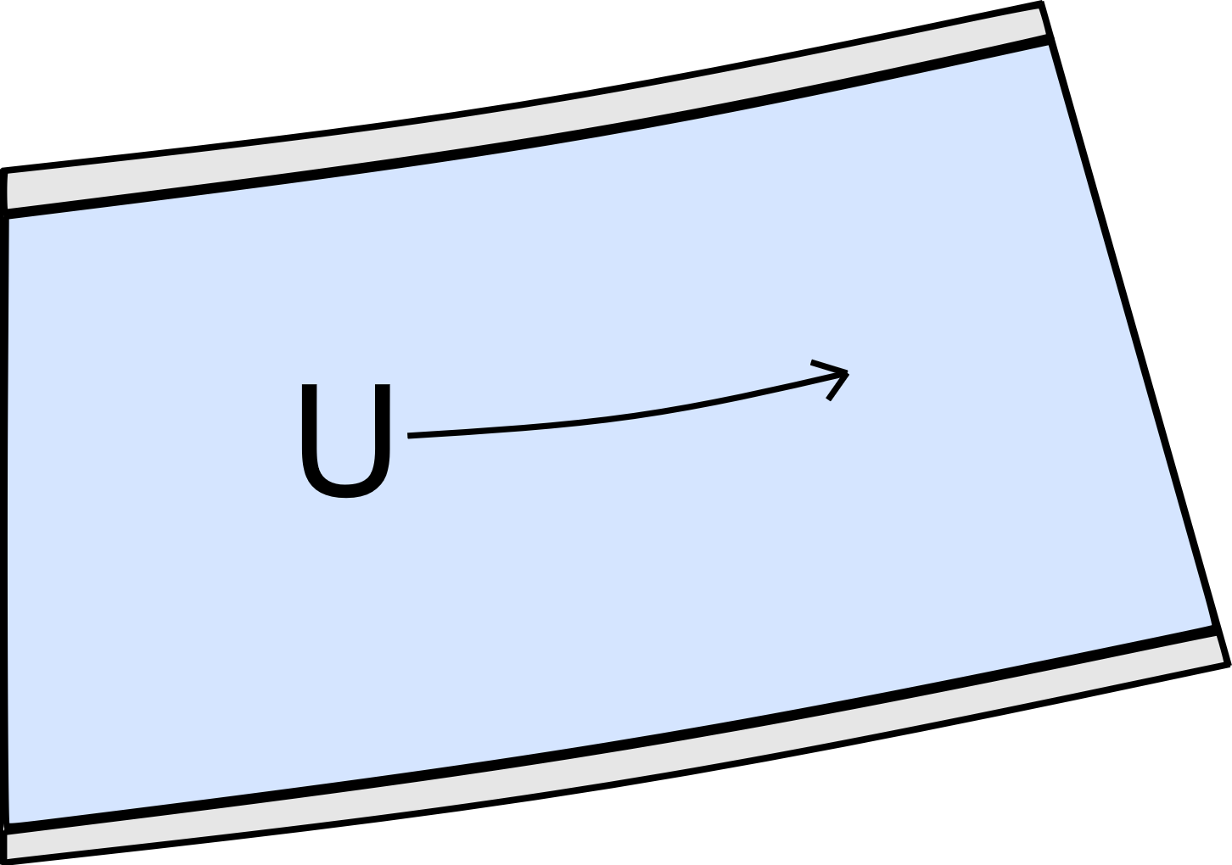
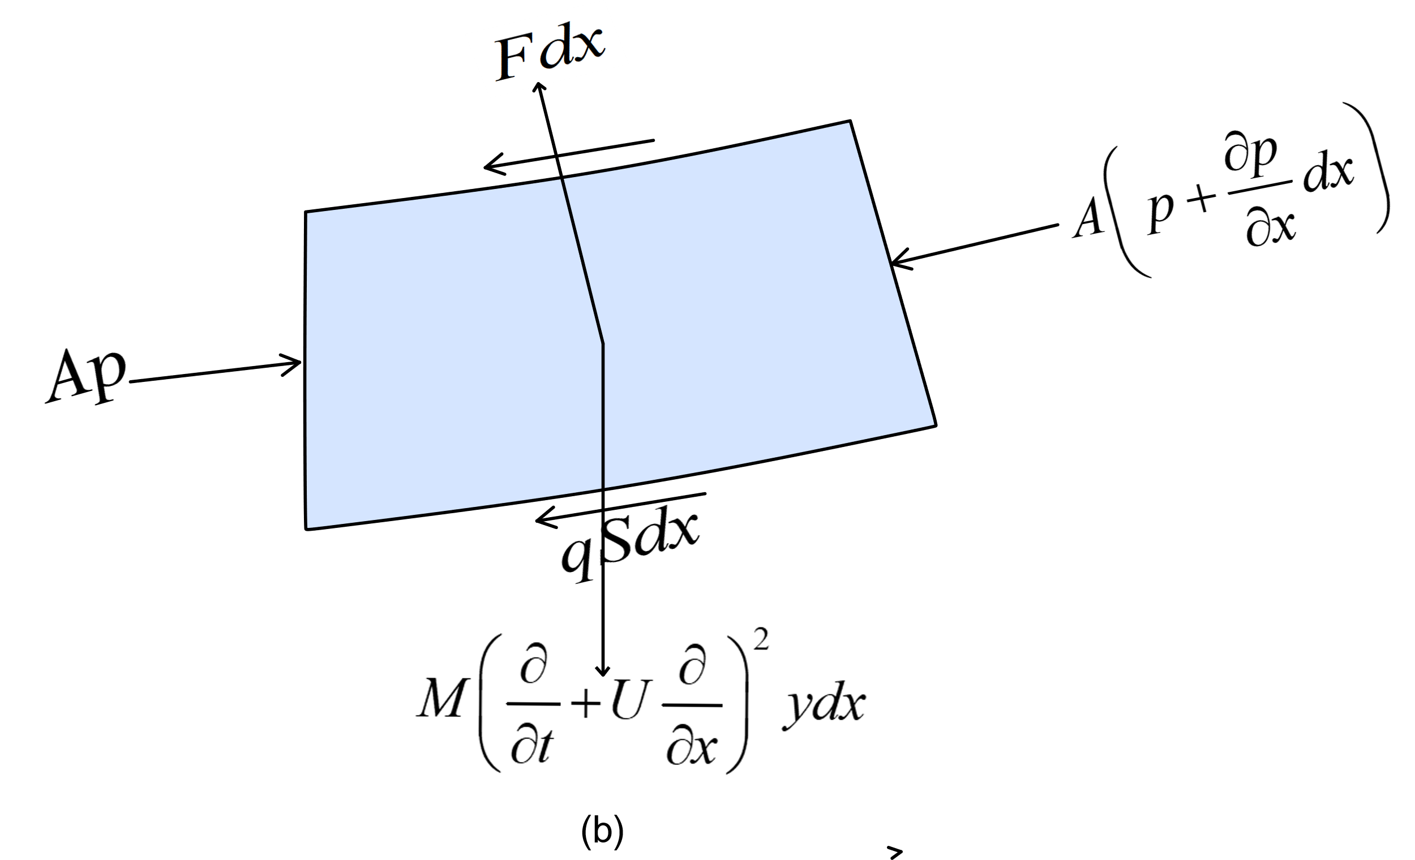
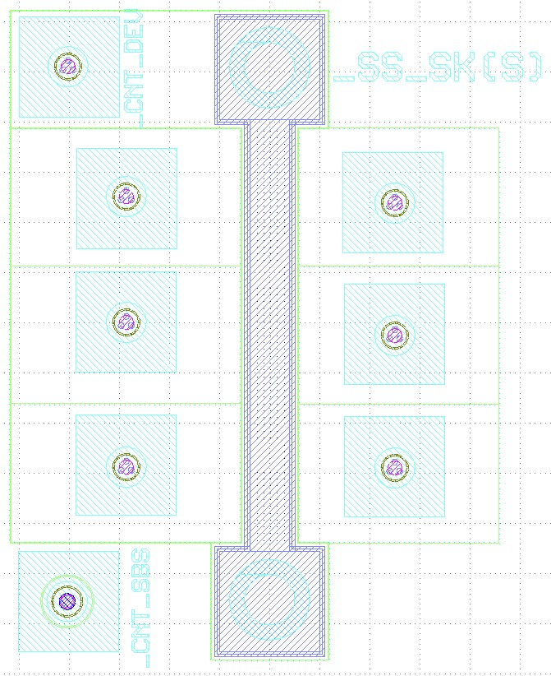
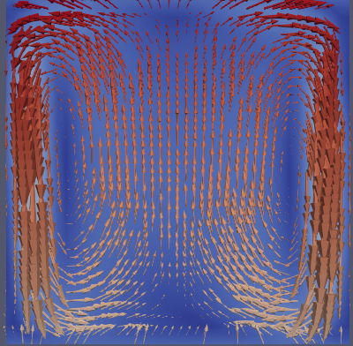
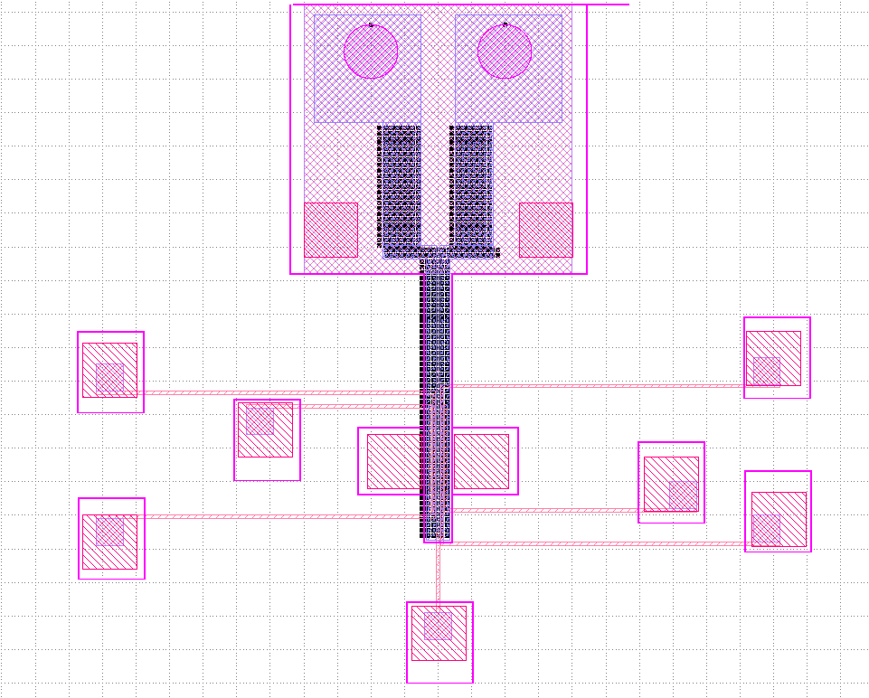
Dynamics of Suspended Microchannel Resonator
Layout Designs : Microchannel Resonator
Circulation inside resonating microchannel

Slide 3
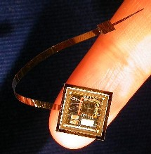
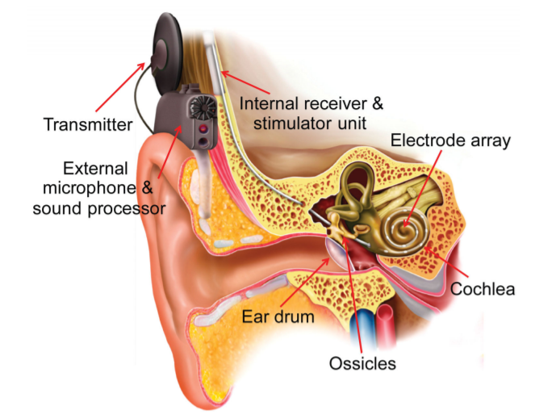
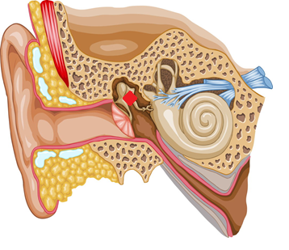
Design & Fabrication of Neuromorphic COCHLEA based on Piezoelectric MEMS Resonator
Piezoelectric sensor
Electrode Array - stimulate the auditory nerve inside the cochlea
No Battery, No wireless transceivers or signal processors
Piezoelectric transducer - act both as frequency detector & an energy harvester
Conventional Cochlear implant
Fully implantable Biomimetic MEMs Cochlea
Anju Sebastian MEMS COCHLEAR IMPLANT 1

Slide 4

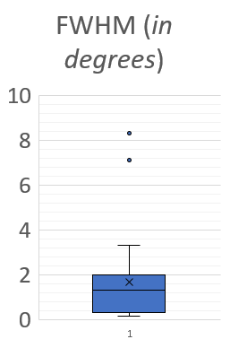
Cochlear Implant: AlN Growth
FWHM from 43 published work on AlN growth from 2005 to 2016
D₃₃ from published work 1999-2010
We are Here

Slide 5


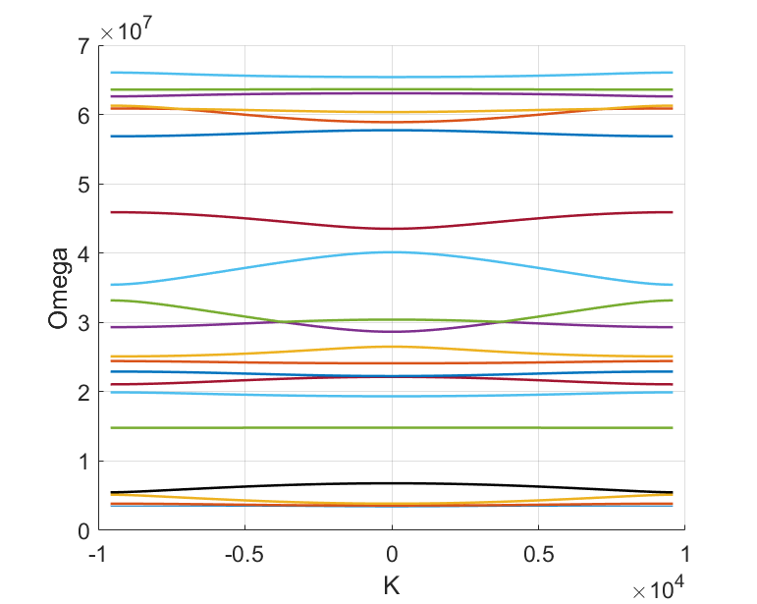
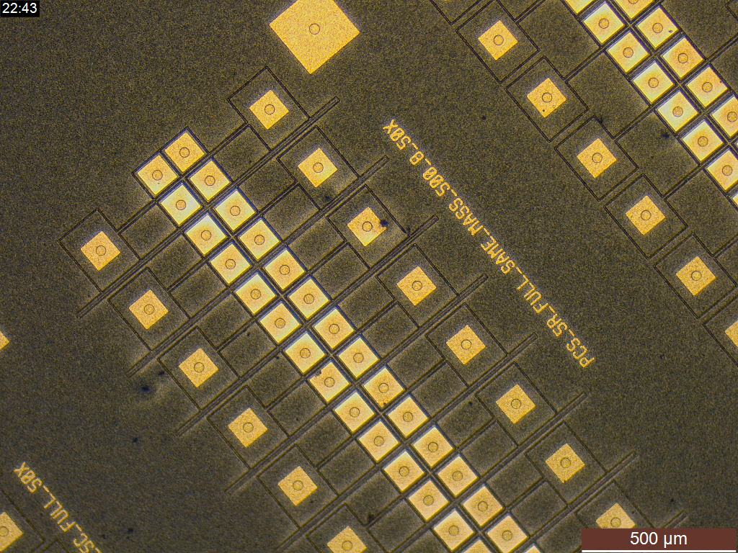
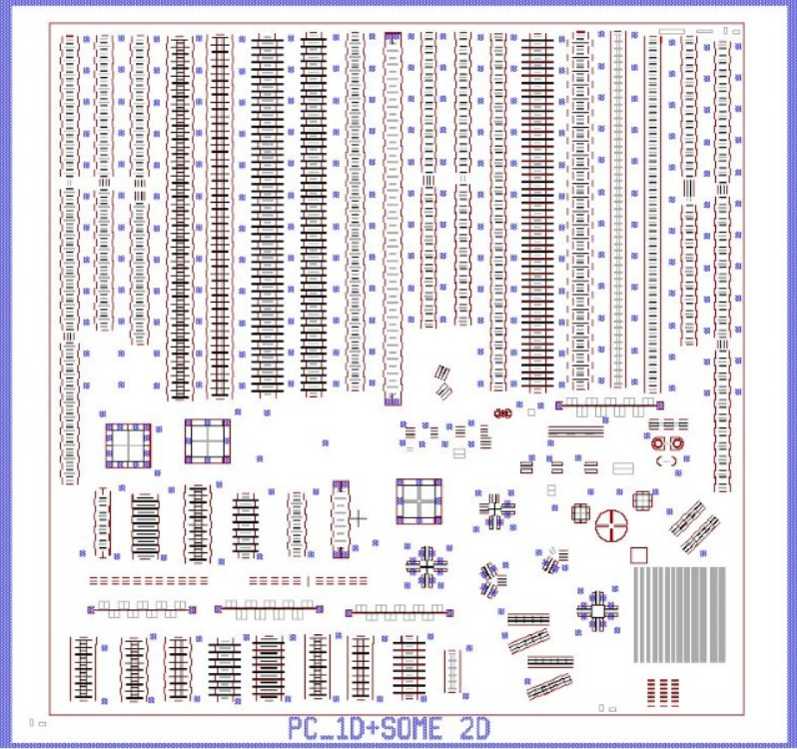
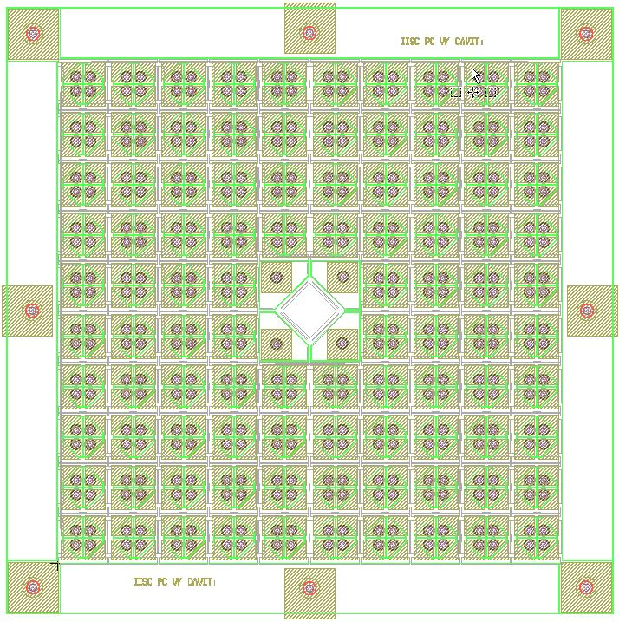
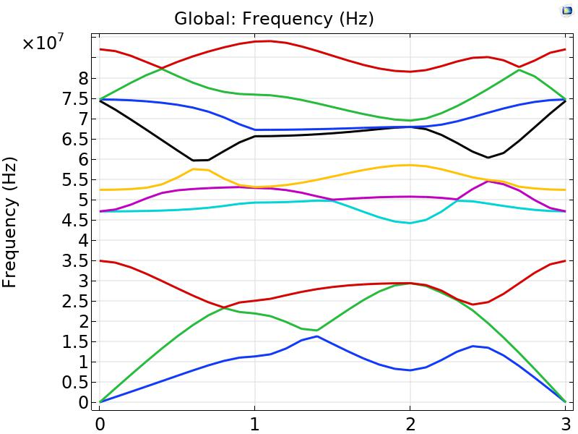
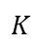
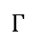
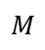
Dynamical study of phononic crystals and its interaction with resonant cavities
1D PCs
Schematic
Layout (L-edit)
Microscopic
Dispersion curve (simulated)
2D PCs
Layout (L-edit)
$$Γ$$
$$K$$
$$M$$
$$Γ$$
Dispersion curve (simulated)
Lithographic Die of PCs
Vishnu Kumar, Indian Institute of Science

Slide 6
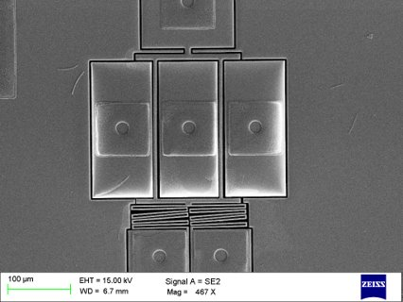
Fabrication Processes
Un-encapsulated (opened) devices
Encapsulated devices
Common steps
Contact Gasket
LTO
Vapor HF
DRIE
Metal deposition
SOI
Metal and LTO etching
LPCVD Poly-Si Cap layer
Vents
Vapor HF
LTO deposition
Isolation Trenches
Oxide deposition
Contact Metal opening
Metal deposition and etching
Open MEMS Resonator
Vishnu Kumar, Indian Institute of Science

Slide 7
Novel Oscillator Topology
Existing topologies : use large number of electronic circuits which add noise to the output.
This work : uses novel method to reduce noise by reducing the requirement for electronic circuits.
Existing Oscillator Topology
New Oscillator Topology
Sinusoidal input voltage
Sinusoidal output current
Sinusoidal input voltage
Sinusoidal output voltage
MEMS Resonator
MEMS Resonator
Amplifier
&
Phase correcting circuit
Transimpedance amplifier
Buffer

Slide 8
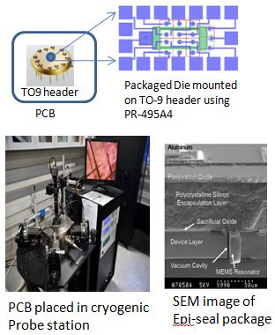
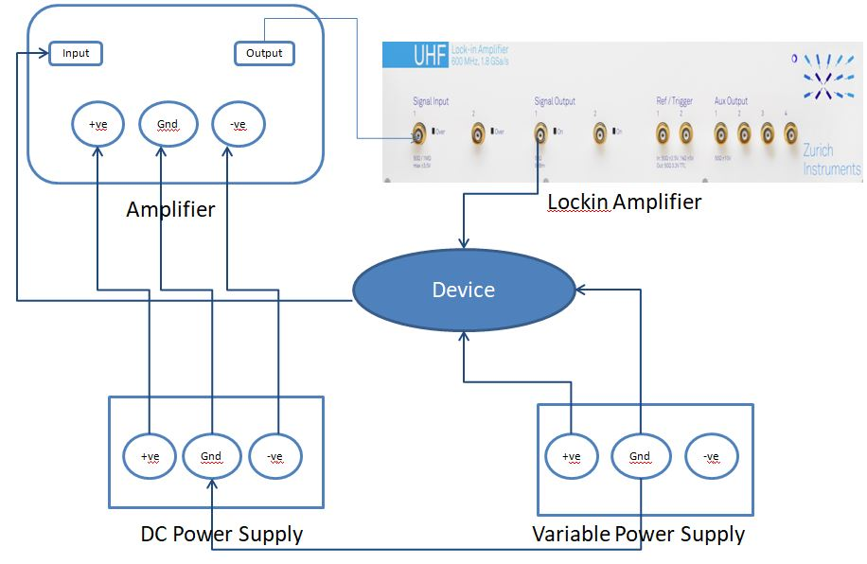
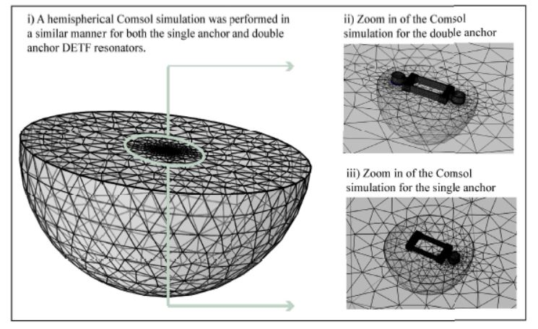
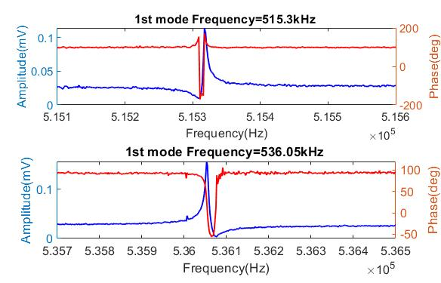
Clamping Loss in MEMS Resonators
Device under measurement for low temperature
Frequency sweep measurement set-up
PML Simulation depicting the failure of the existing model for Clamping loss[1]
Frequency sweep of different modes for DETF
[1] Janna Rodriguez , Saurabh Arun Chandorkar , Grant M. Glaze , Dustin D. Gerrard, Yunhan Chen , David B. Heinz, Ian B. Flader, and Thomas W. Kenny

Slide 9
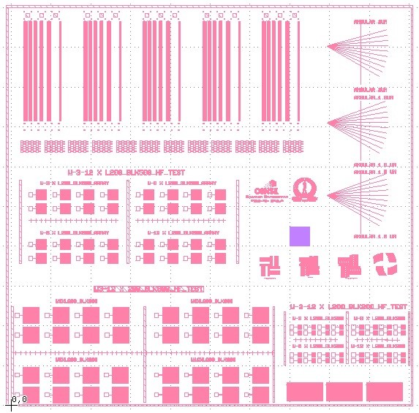
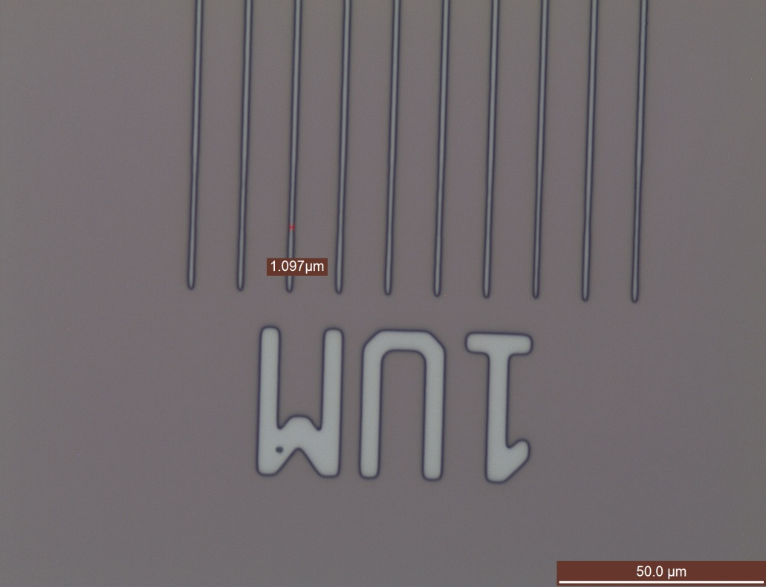
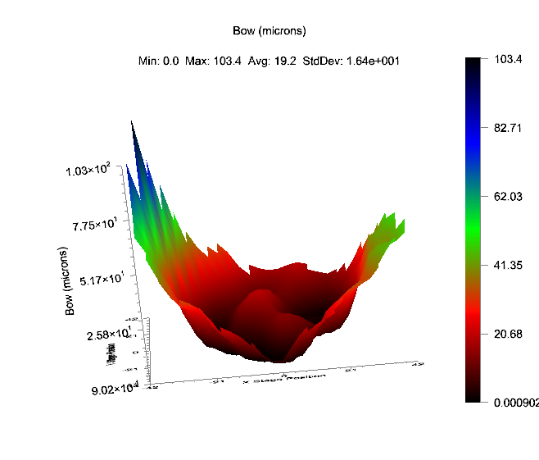
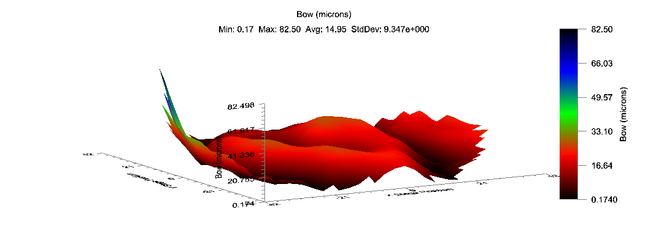
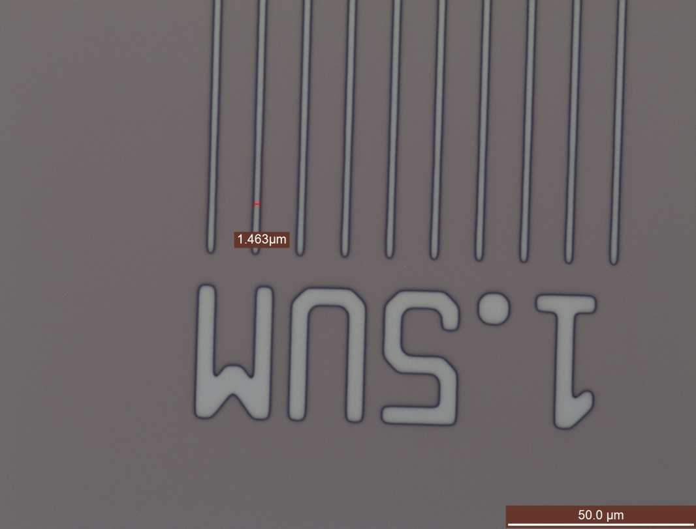
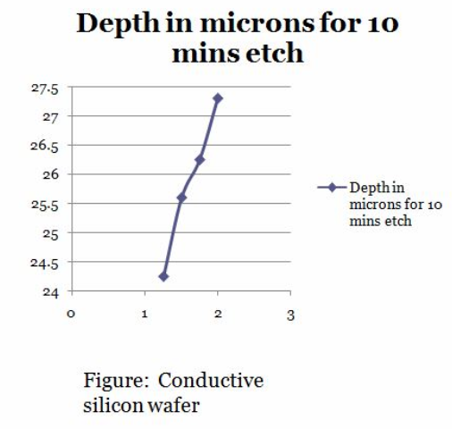
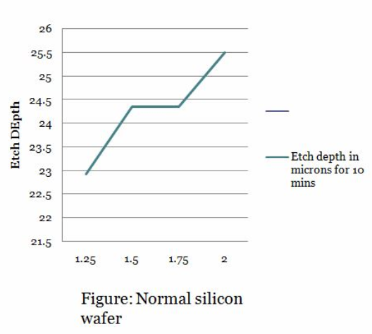
Optimization of Un-encapsulated and encapsulated fabrication processes
Test structures
Wafer Bow Correction
Lithography Optimization
LTO optimization
DRIE optimization
Bhargavi B.A. , Project Assistant

Slide 10
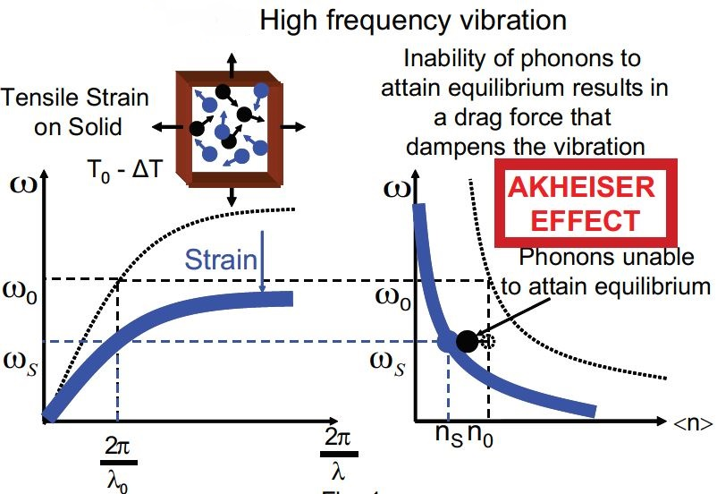
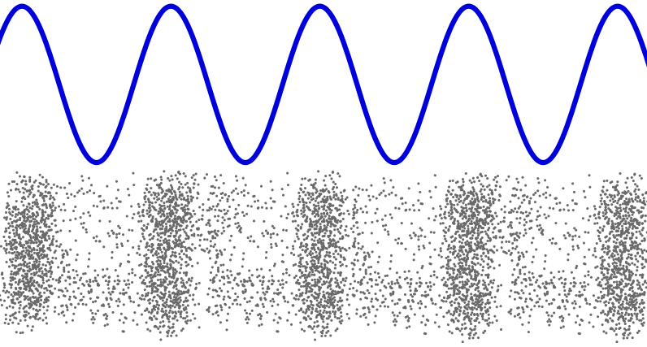
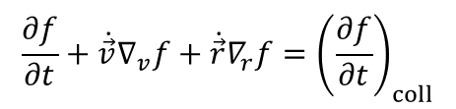
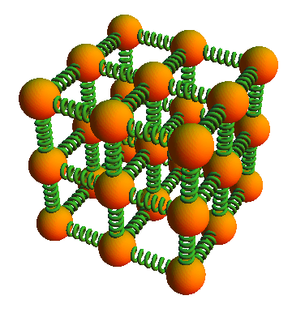
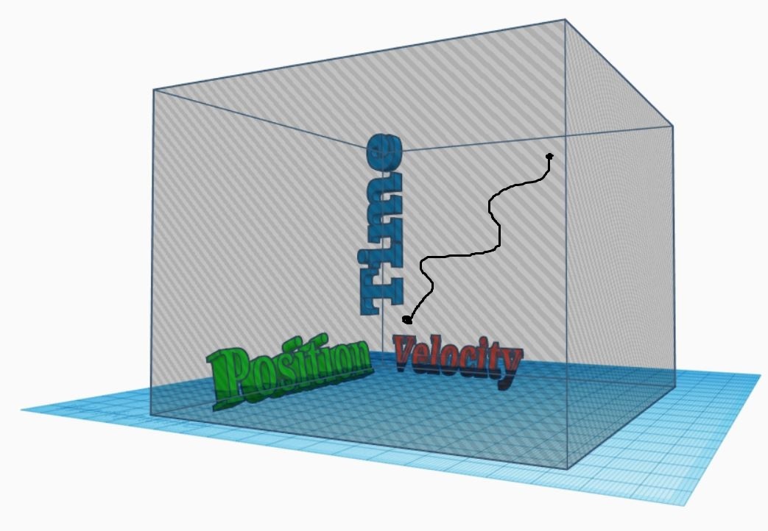
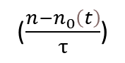
Akhieser Damping in MEMS Resonators
Boltzmann Transport Equation:
@high Frequency
No Driving Field
Relaxation Time Approx.
0
0
($\frac{n−n_{0}\left(t\right)}{τ}$)
Crystal ANHARMONICITY
Find
ENERGY LOSS
Calculate:
ENTROPY Generation

Slide 11
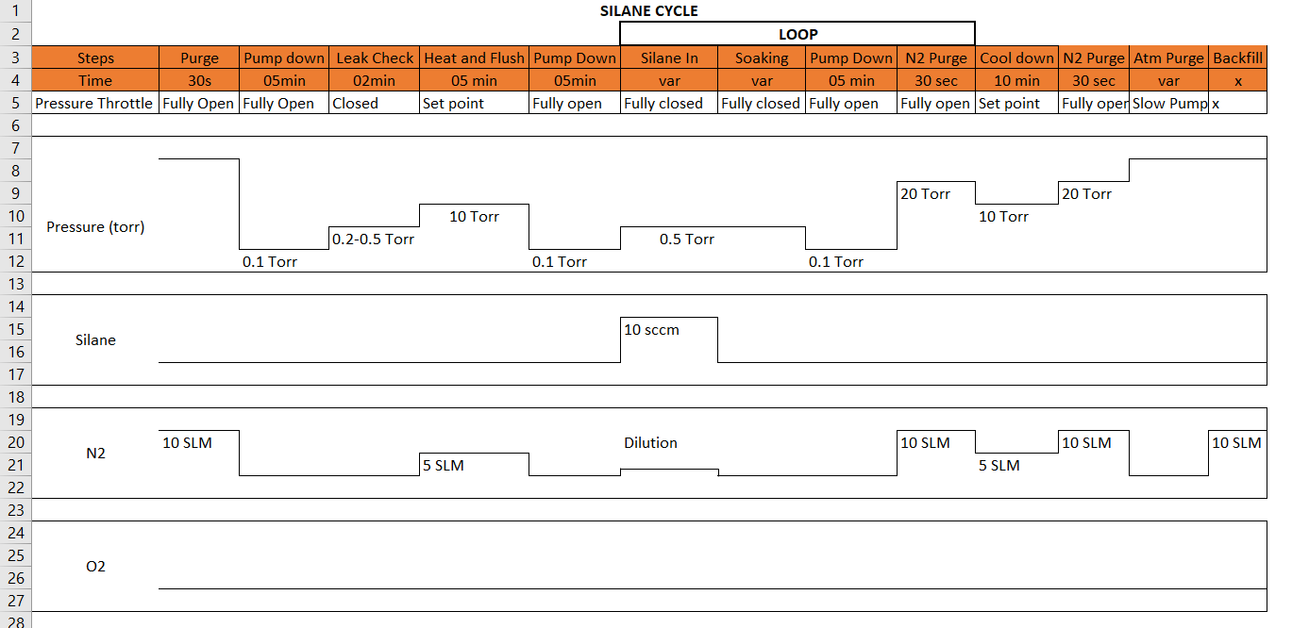
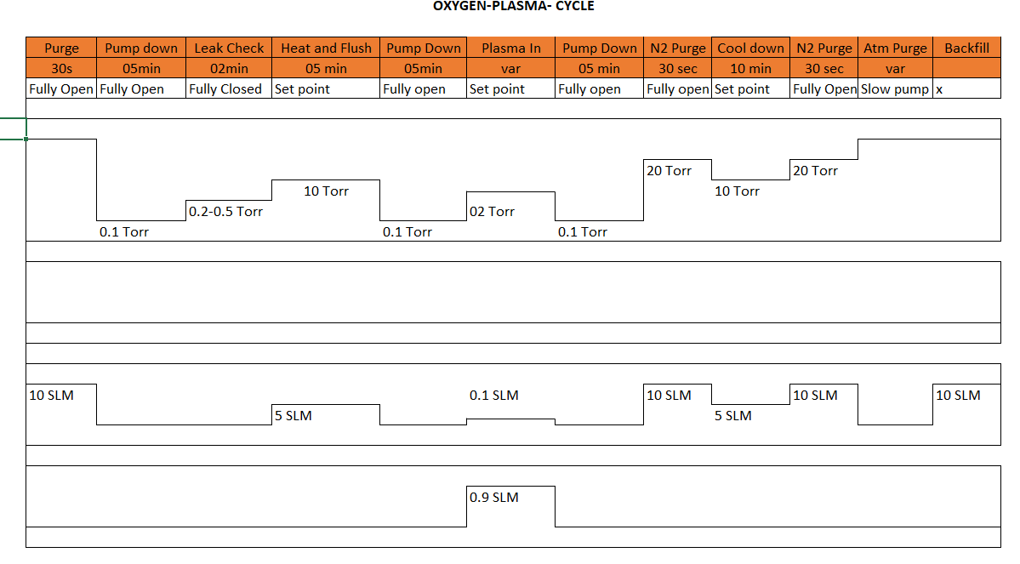
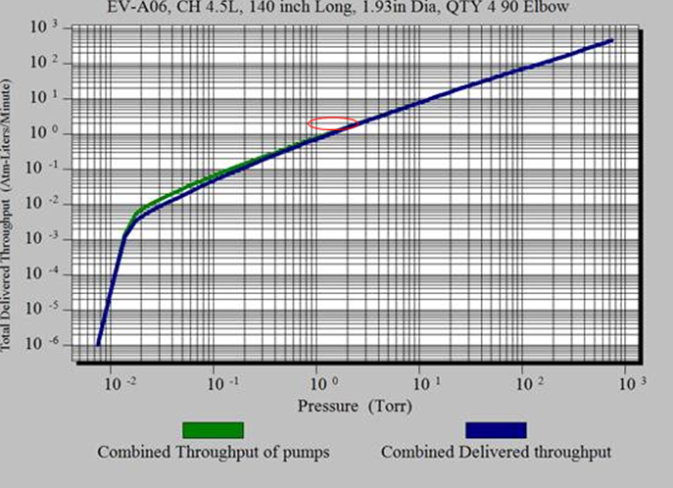
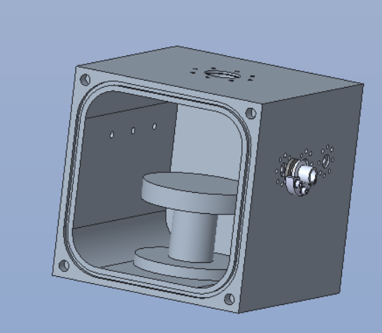
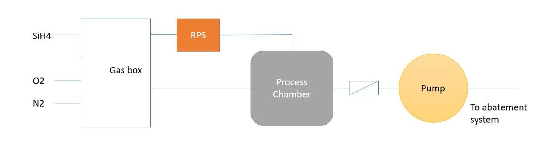
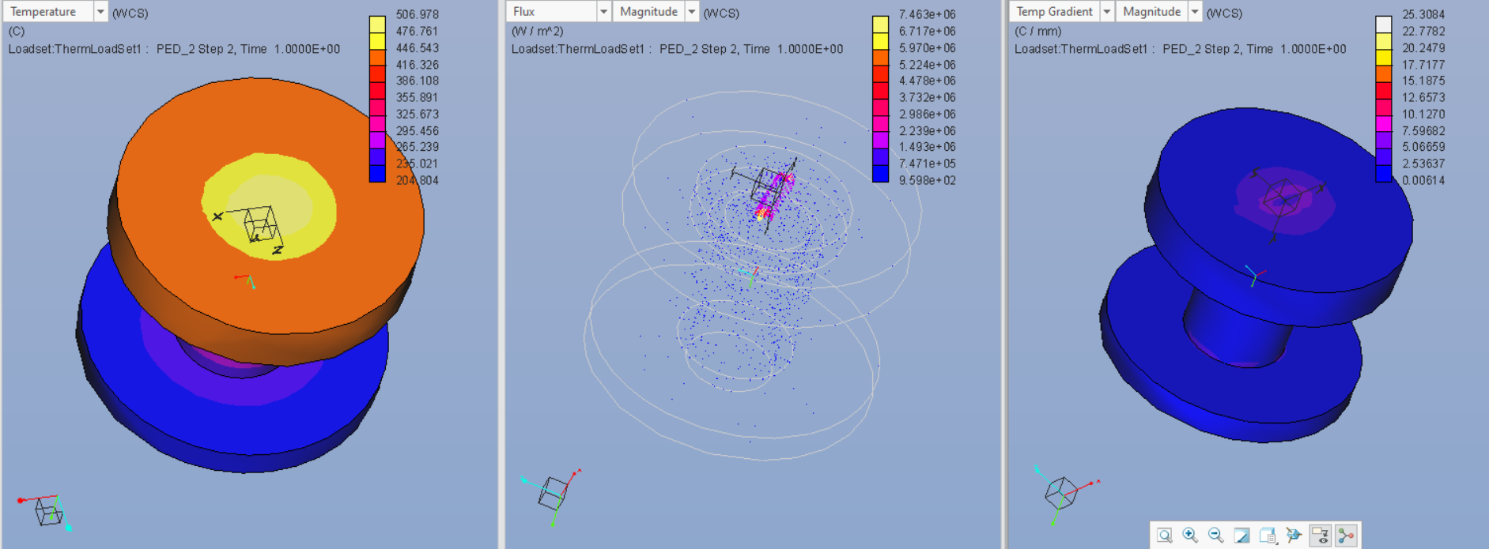
Accelerated test of O-rings
Problem Statement: -
With microfabrication tools reaching increasing operating temperatures, LAM would like to study what structural and performance changes take place in O-ring in such tools when these O-ring reach temperatures surpassing their rated limits.
Test setup: -
For this purpose, we will in collaboration build a test setup for accelerated test of O-ring.
This setup will be capable of exposing the O-ring to desired process gases (Silane and Oxygen Plasma) at the elevated temperature under vacuum conditions, while ensuring that process gases are handled safely.

